Slide 1
WIZZ AIR
CABIN CREW RECRUITMENT - SUCEAVA
Notes:
General advices
do speak slowly
explain all the important details
do NOT use WIZZ-specific abbreviations like, HP, LS, OTET, CA, SC, CRDO because people won’t understand what you are talking about. If you talk about these, please explain them properly (paid holiday, sick leave, on time every time, cabin attendant, senior cabin attendant, crew requested day off/off days granted for sure, etc.)
stop every now and then and ask the candidates if they have any questions
Aircraft does not have plural!!!! 1 aircraft, 2 aircraft, 10 aircraft, 1,000 aircraft

Slide 2
WIZZ AIR TODAY
FLEET
230 Airbus aircraft 64% of the fleet is neo technology
EMPLOYEES
8,600 colleagues
ROUTES ON SALE
800 routes
Nearly 200 destinations​
50+ countries​
PASSENGERS
62,8 million
In 2024
BASES
33 bases in 16 countries
Notes:
Bases and countries are counted with suspended Kyiv, Lviv (Ukraine), Chisinau (Moldova)

Slide 3
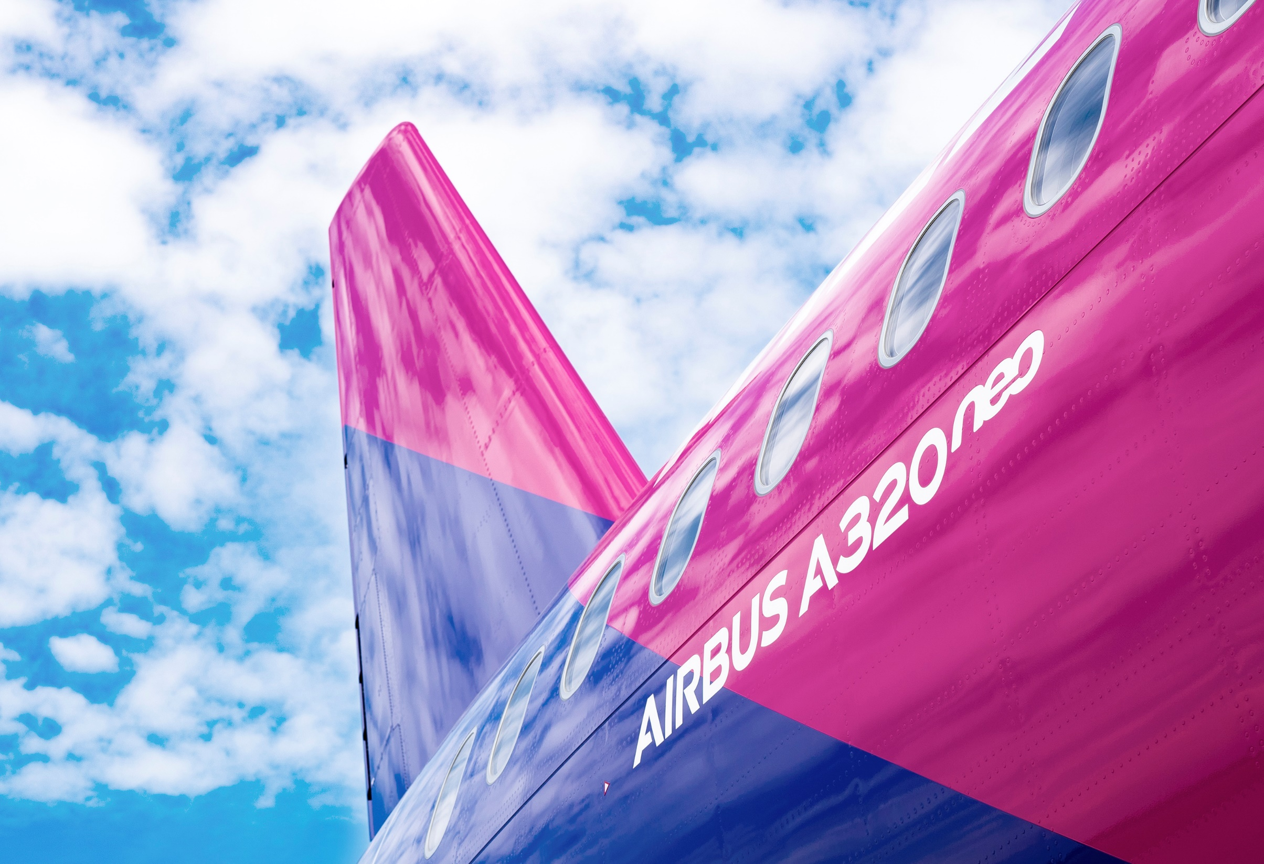
32 WIZZ BASES IN 16 COUNTRIES
ALBANIA
AUSTRIA
BULGARIA
CYPRUS
GEORGIA
HUNGARY
ITALY
LITHUANIA
NORTH MACEDONIA
MOLDOVA
POLAND
ROMANIA
SERBIA
UKRAINE
UNITED ARAB EMIRATES
UNITED KINGDOM
Tirana
Vienna
Sofia, Varna
Larnaca
Kutaisi ​
Budapest
Rome Fiumicino, Milan Malpensa, Catania​, Naples, Venice Marco Polo
Vilnius​
Skopje ​
Chisinau
Katowice, Krakow, Warsaw, Gdansk, Wroclaw ​
Bucharest, Cluj-Napoca, Craiova, Iasi, Sibiu, Timisoara, Suceava
Belgrade ​
Kyiv, Lviv
Abu Dhabi
London Luton, London Gatwick

Slide 4
AGENDA
CABIN CREW OPEN DAY
Short company intro
English proficiency test
Personal introductions
Situational role play
Team play
Company presentation
Individual interviews
4
Notes:
Please explain the course of the day
Tell participants what they should expect
to be called in individually first
That you will make a decision after each round and only the successful candidates will make it to the next round
Tell them how long you think the day will last (based on the number of people present at the event)
Mention that you will assign a number to each of them because of GDPR issues and you will all them by the number

Slide 5
our basic requirements
Age: min. 18 years
Arm reach: min. 210 cm while standing on tiptoes
Degree: min. high school degree or equivalent (Bacalaureat diploma is mandatory)
Spoken languages:
fluent – written and spoken – English
Advantage: if you speak an additional European language

Slide 6
our basic requirements
Please note…
The ability to swim without any aid
Right to work and live in Romania
Living within 60 minutes of SCV airport
being prepared to make this journey upon work schedule
If you wear glasses or contact lenses and your prescription is above +5 or below -5, you are unlikely to pass the mandatory medical examination

Slide 7
our basic requirements
Is the position aligned with your skills and personality?
A Wizz cabin attendant is:
An enthusiastic person who likes working with people
Provides excellent customer service and creates a friendly atmosphere on board
Has calm and solution-oriented behavior in the challenging situations
Welcomes passengers with a smile and helps them during the flight
Manages in-flight sales and cash handling
Arrives at work on time, adequately rested and properly presented in order to provide these services at the highest level

Slide 8
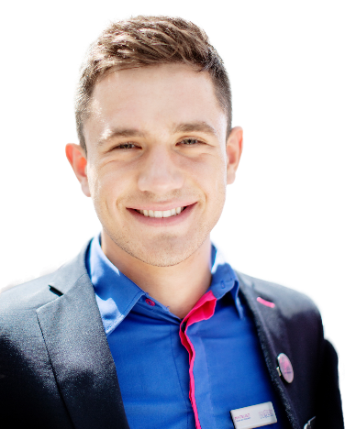
What we can offer
A competitive salary
A stable job at a rapidly developing company
A friendly and multicultural work environment
Career opportunities
Discounts on flights & bonus airline tickets (even for your family and friends)
Complete and free Cabin Crew training
Training allowance
The possibility of always being at home (Suceava)

Slide 9
TRAVEL BENEFITS
€
UNLIMITED STAFF TRAVEL
TRAVEL PARTNER
FIX FARE FOR TRAVEL PARTNERS
BONUS TICKETS
Fixed price of 25 Euro for employees
Discounted tickets for your travel partners
For one booking per calendar year
Several bonus tickets (for free) are handed out per year (all services included)
Notes:
Unlimited number of CONFIRMED!!! Staff tickets for 25/50€ per sector
Please emphasize that while other airlines offer standby tickets, at WIZZ whatever you book is confirmed
Checked in bag, WIZZ priority, free airport check in included
Travel partner
5 travel partners per calendar year
They can be anyone: parents, sister/brother, wife/husband, friend, anybody
25% off the actual WIZZ Discount Club fare
CONFIRMED TICKETS
FIX FARE FOR TRAVEL PARNTERS
Once a year you can book fix fare tickets of 25/50 EUR for yourself and for your travel partners as well
Checked in bag, WIZZ priority, free airport check in included
CONFIRMED TICKETS
BONUS TICKETS (don’t call them Xmas tickets because it is only an internal way of talking about them)
We receive a number of bonus (free) tickets every year
These tickets include 32kg checked in bag, WIZZ Priority and free airport check in
You can use it for any of our routes anytime
You can use it yourself or
Give it to any of your family members
Give it to any of your friends
Give it to anybody you want to.
The only thing you cannot do, is sell them
THESE ARE ALSO CONFIRMED TICKETS
These cheap/free travel options will really open the world for you, because you won’t have to think twice if you want to go on a short or even long vacation alone or with your family/friends
These options themselves are worth thousands of Euros!

Slide 10
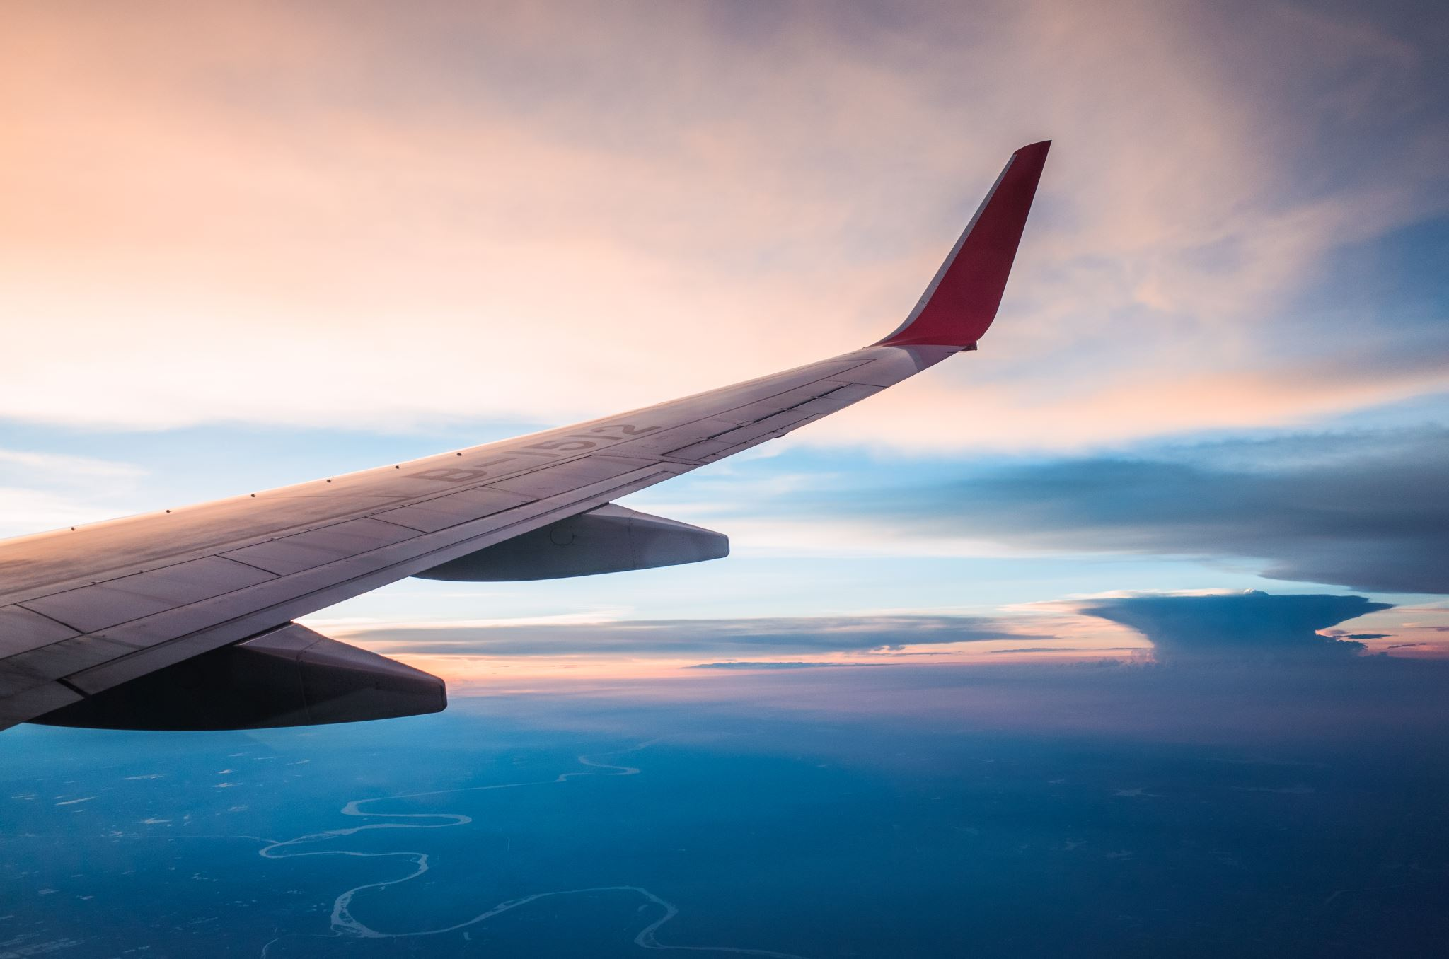
Thank you!
If you need further help, please contact cabincrewrecruitment@wizzair.com!

